Slide 1
Gesture Remote Control
ECE 4180 - Final Project
Project link: https://developer.mbed.org/users/sjackson64/notebook/gesture-remote-control/

Slide 2
Team members
Tue Tran (Section A)
Carden Bagwell (Section B)
Sam Jackson (Section B)

Slide 3
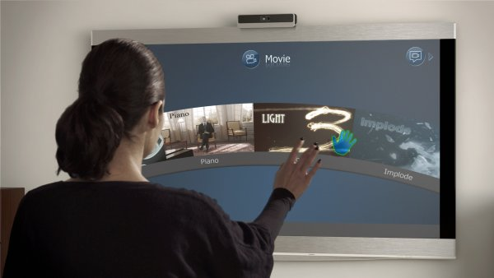
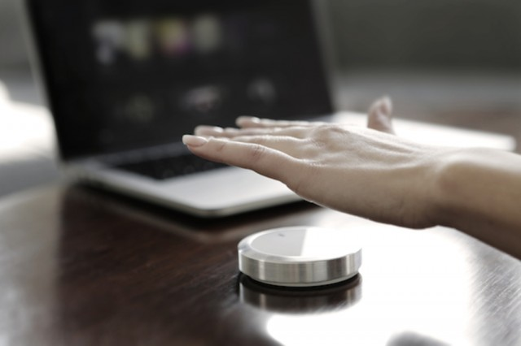
Motivation
Using hand gesture to control TV or Set-top box
Channel control
Volume control
Power (on/off) control

Slide 4
Solution
Use the Gesture Sensor to select modes (Power, Channel, and Volume)
Hold hand above the Gesture Sensor for 3 seconds to send Power on/off signal
Hold hand above the Ultra-sonic Ranger in Channel mode for channel up and down
Hold hand above the Ultra-sonic Ranger in Volume mode for volume up and down
Use IR receiver to get sample IR signals from the regular remote
Use IR Power LED to send IR signals back to the TV/Set-top box

Slide 5
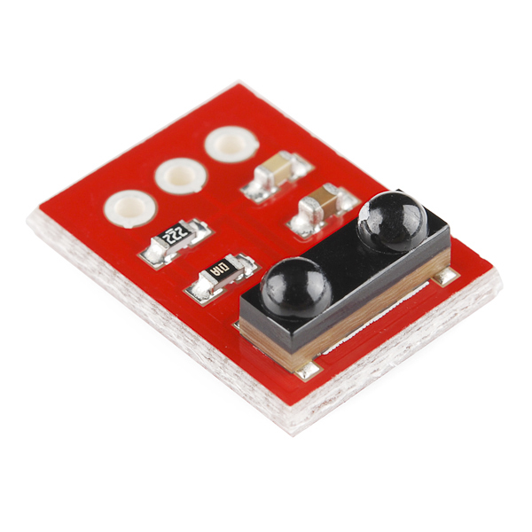
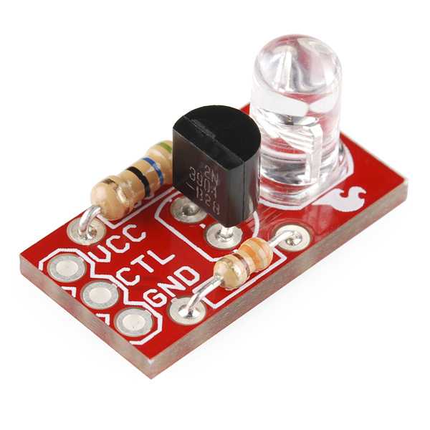
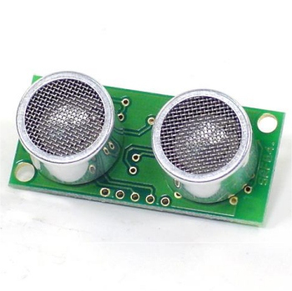
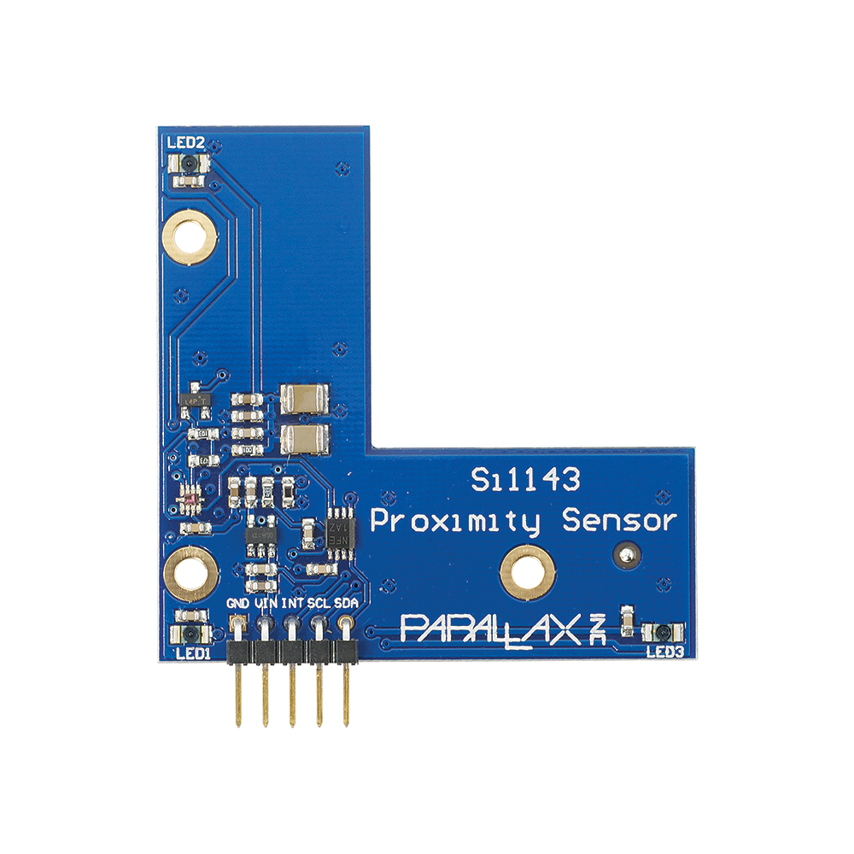
Parts
mbed NXP LPC1768
SparkFun IR receiver TSOP85
https://www.sparkfun.com/products/8554
SparkFun Power IR LED
https://www.sparkfun.com/products/retired/10732
Parallax Si1143 Gesture Sensor
https://www.parallax.com/product/28046
Polaroid Ultrasonic Ranger SRF04
http://www.robot-electronics.co.uk/htm/srf04tech.htm

Slide 6
Demo
https://www.youtube.com/watch?v=ekOjm8Pc0e0

